Slide 1
Compact Modeling of τ and β of Detrapping 20250228 진명

Slide 2
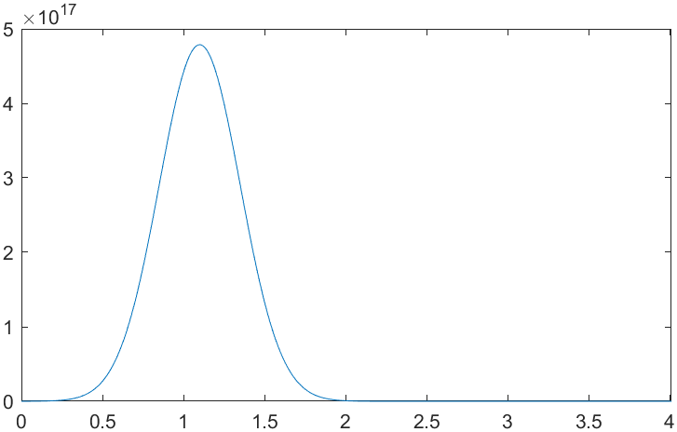
** 정정사항 ** - β Value of Detrapping
일반적인 Single trap 의 경우에는 대략 β = 0.6-0.7
하지만, sigma + t_{N1} 변수 도입시, β = 0.2-0.3
=> 예상보다 변수 도입 시 β값 감소 폭이 매우 컸음.
Trap profile setting : only One Gaussian profile
Parameter of trap profile:
- μ_{t} , σ_{t}

Slide 3
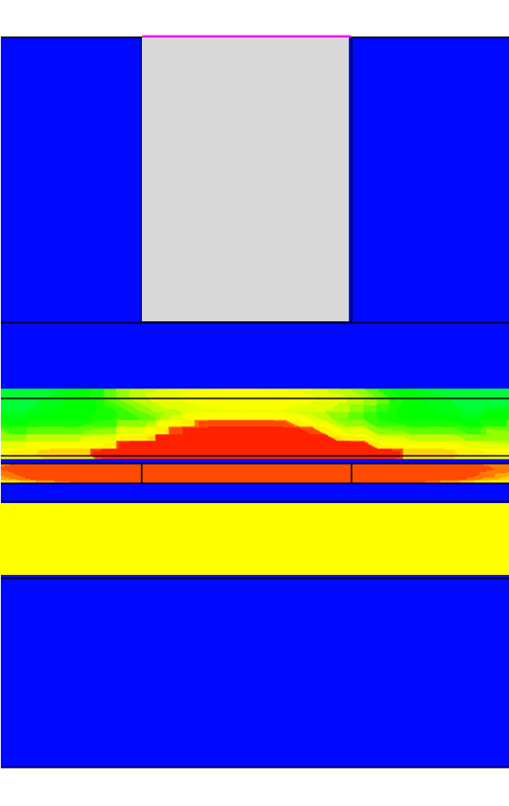
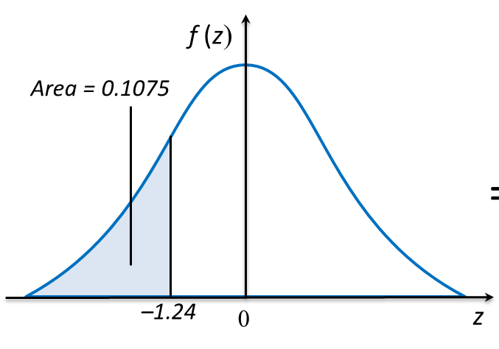

Fitting of Stretched Exponential to Detrapping
- τ Prediction
τ_{min} : close, shallow trap time constant
(t_{O1}-t_{N1} interface / E_{t} = μ_{t} – 1.24σ_{t})
τ_{max} : far, deep trap time constant
(t_{N1}-t_{O2} interface / E_{t} = μ_{t} + 1.24σ_{t})
τ_{min}
τ_{max}
$τ=\sqrt{τ_{min}τ_{max}}$
1.24σ_{t} : Gaussian Table에서 10%만 빠지는 지점
-10%
τ_{min}

Slide 4
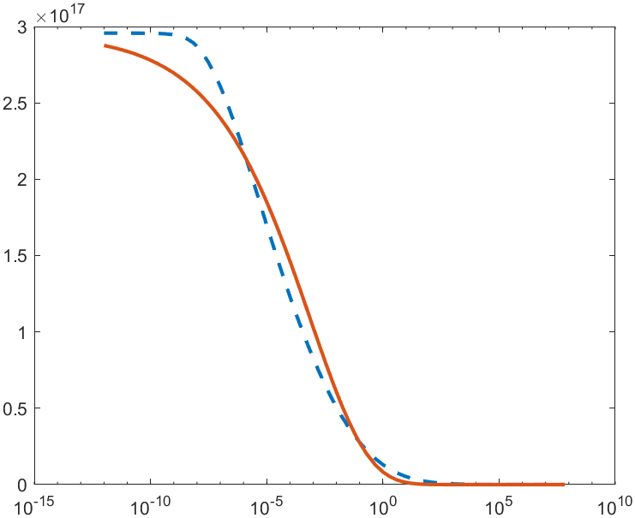
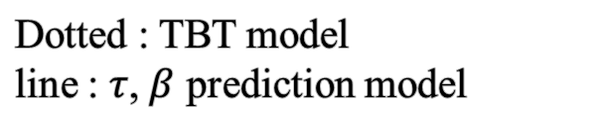
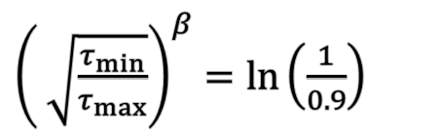

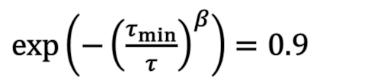


Fitting of Stretched Exponential to Detrapping
- $β$ Prediction
$\exp\left(−{\left(\frac{τ_{min}}{τ}\right)}^{β}\right)=0.9$
$τ=\sqrt{τ_{min}τ_{max}}$
${\left( \sqrt{\frac{τ_{min}}{τ_{max}}}\right)}^{β}=\ln\left(\frac{1}{0.9}\right)$
$β=\frac{\ln\left(\ln\left(\frac{1}{0.9}\right)\right)}{\ln\left(\sqrt{\frac{τ_{min}}{τ_{max}}}\right)}$
$β=\frac{\ln\left(\ln\left(\frac{1}{0.9}\right)\right)}{\ln\left(\sqrt{\frac{τ_{min}}{τ_{max}}}\right)}$
Dotted : TBT model line : $τ$, $β$ prediction model

Slide 5
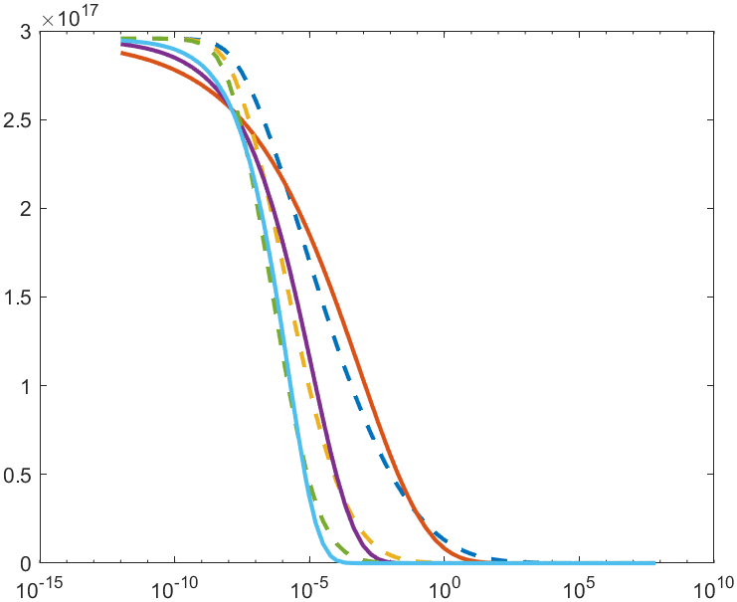
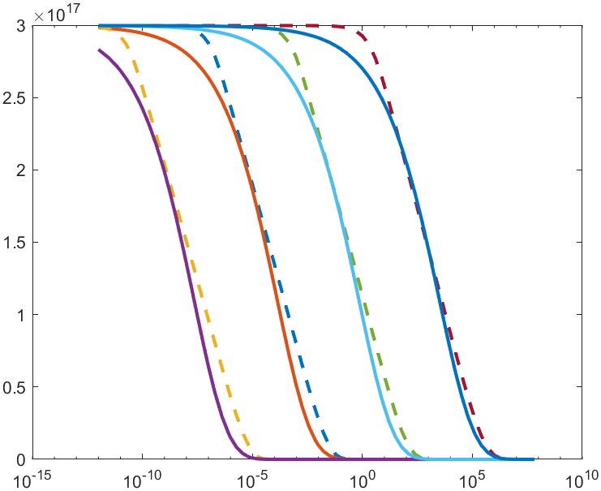
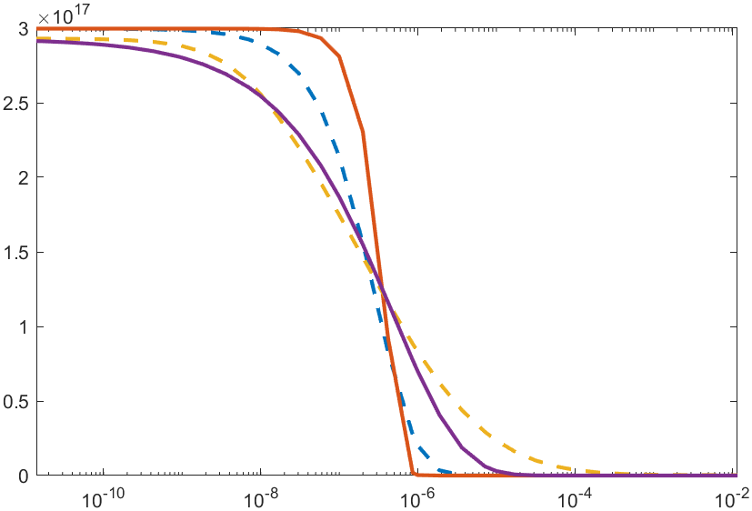
Fitting of Stretched Exponential to Detrapping
t_{N1} variation
t_{O1} variation
σ_{t} variation
Well compensates with variations of device scale & trap profiles

